Slide 1
3-part
Open Program
Advanced Exercises
Graduation Internship Preparation
Potential Project
Feasibility Research

Slide 2
Advanced Exercises

Slide 3
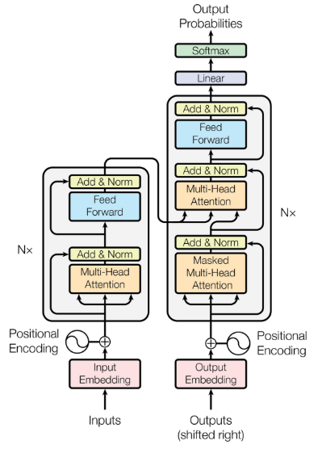
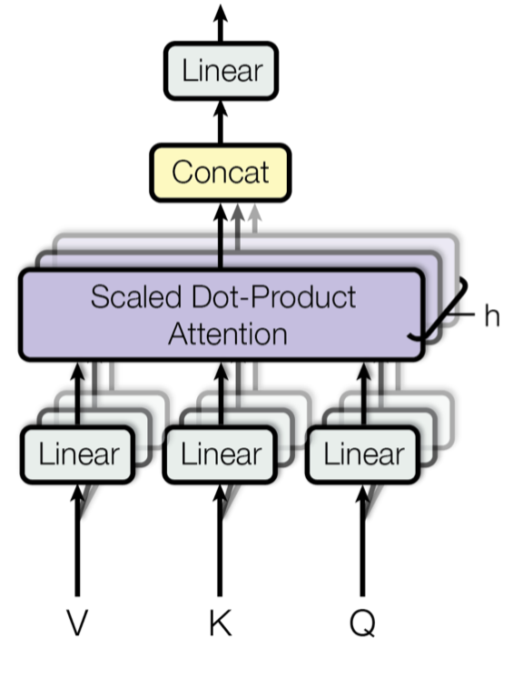



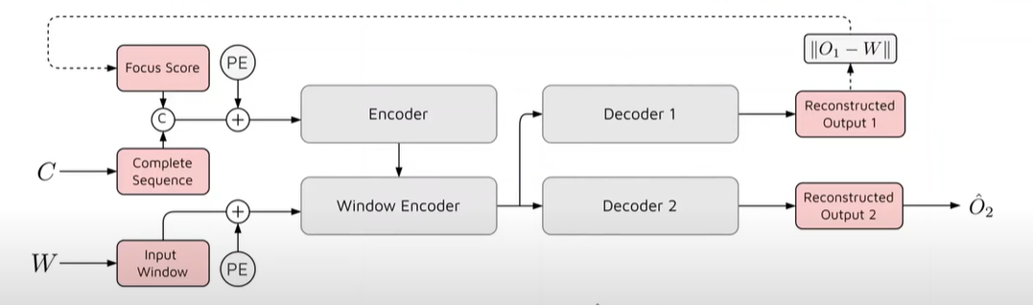

NLP - Transformers

Slide 4

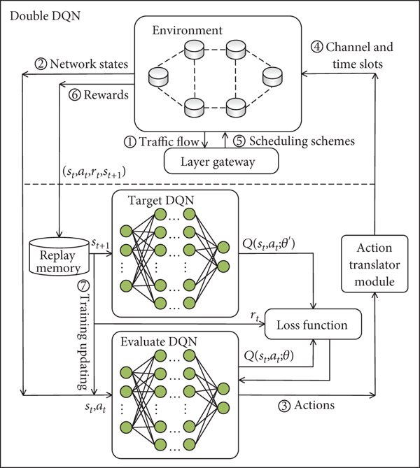
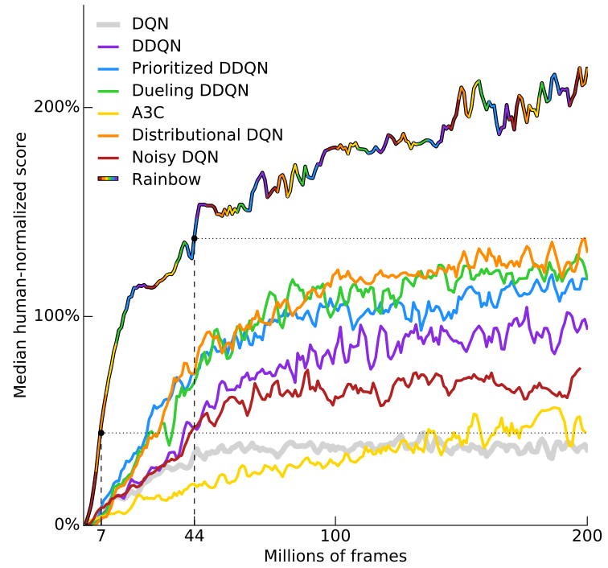
Reinforcement Learning
Agents/Models

Slide 5
Naive Bayes
A coin bag with three coins, one is pulled out and you see the face. Predict the other side of the coin.

Slide 6
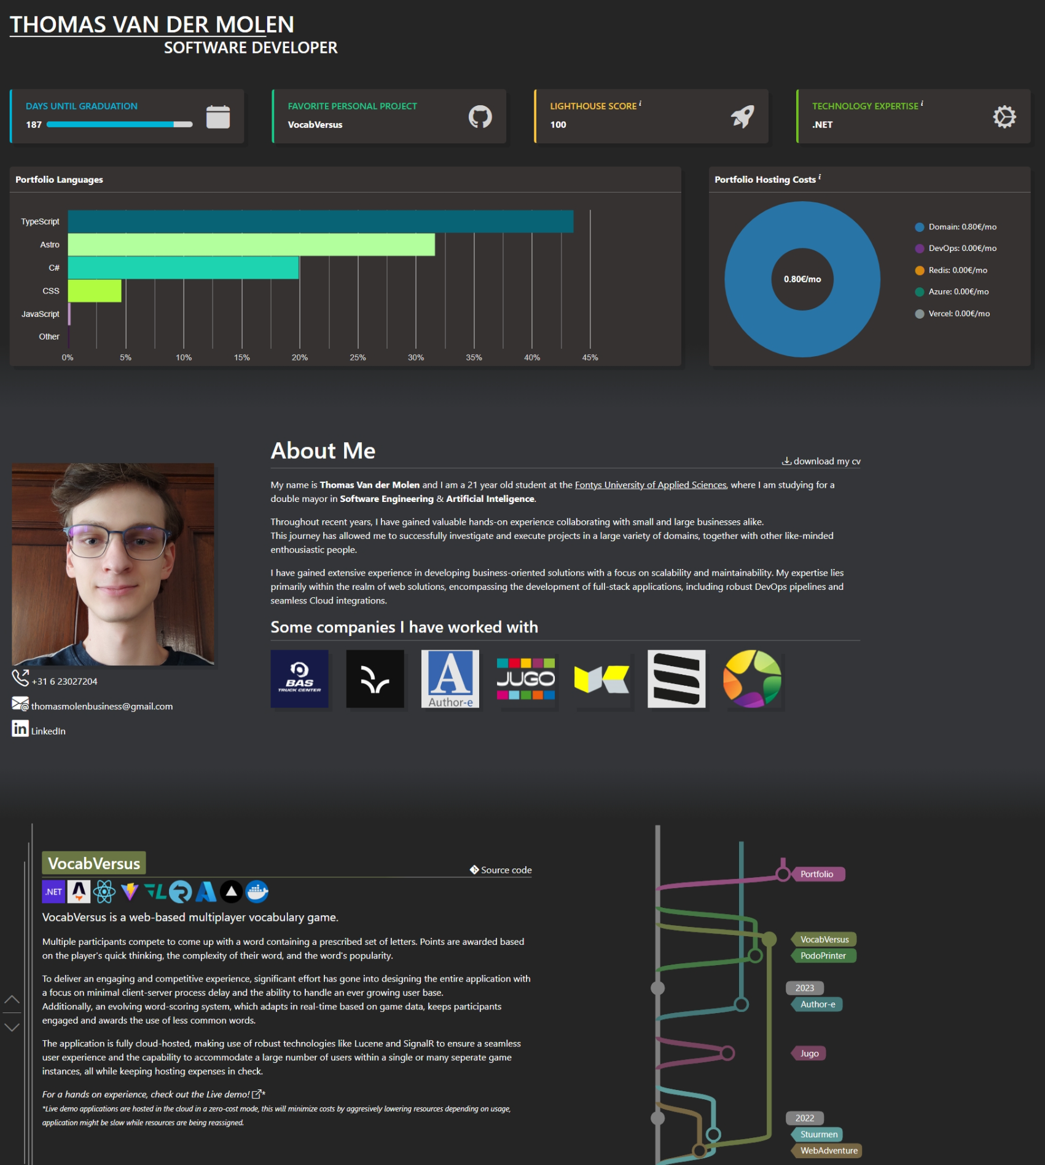
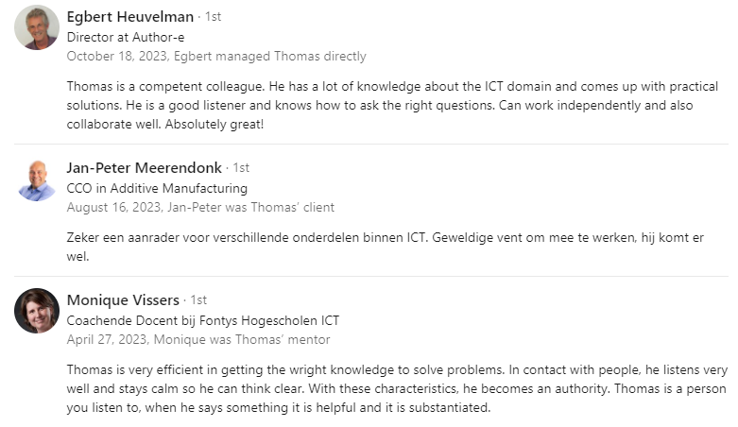
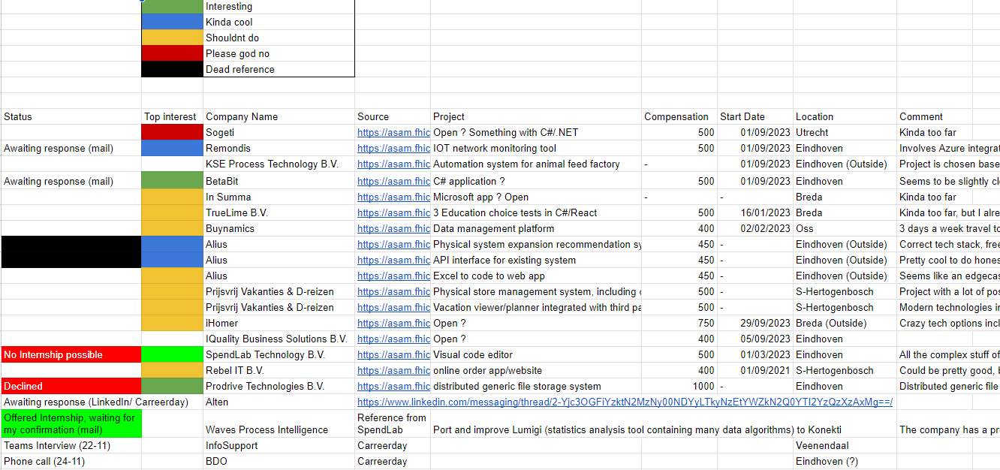
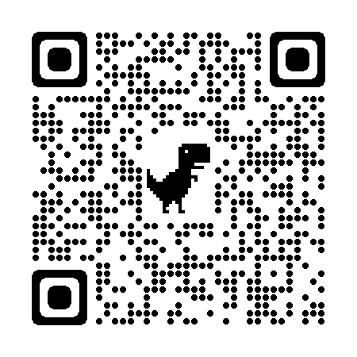
Graduation Internship Preparation

Slide 7
Potential Project
Feasibility Research

Slide 8
Leveraging Reinforcement Learning for Automated Testing

